Slide 1



Handwritten Digits Recognition using Convolution Neural Networks
Master of Business Administration (Data Science & Analytics) Batch 2019 –2021.
Mini Project Presentation (UNDER THE GUIDANCE OF Dr. B. LAKSHMA REDDY)
Khadeer Pasha
(Reg No. MB191317)
(under the Supervision of Regex Team)
JTM I Floor, Jagatpura, Jaipur
SJES COLLEGE OF MANAGEMENT STUDIES, MEDAHALLI, BANGALORE- 49

Slide 2
The presentation's main goal is to show how the Convolution Neural Networks (CNN) deep learning methodology can be used to handwritten digits recognition.
On a predefined 'mnist' dataset for handwritten digit recognition, we will implement a CNN model with Tensorflow module and Keras as the framework.
Recognition of handwritten digits (MNIST,USPS) Variations on LeCun's Convolutional Neural Networks (0.8 percent , 0.6 percent and 0.4 percent on MNIST) Distance between two tangents (USPS) Trees with Randomized Decisions Shape context/TPS matching using K-NN (MNIST) SVM on orientation histograms
Each digit is a grey level image with a resolution of 28 x 28 pixels. The digit itself takes up 20 x 20 pixels in the center, and the box's center of mass is in the middle. It's a strong database for people who want to test out machine learning and pattern recognition techniques on real-world data with minimal preprocessing and formatting effort.

Slide 3
The algorithm then finds the distance between the new vector and the 10 constant vectors.
The minimal distance will give the best matching to one of the constant vectors. The recognition answer will be the digit represented by the constant vector.
For training set I created an example of each digit 0-9 using ms-paint. For testing I created of 0-9 digit images also in ms-paint.
I tried to make each group more different, and assigned different image characteristics to each of them; like image size, marker size and handwriting style.

Slide 4
Load both the datasets for MNIST 0-9 digits and Kaggle A-Z letters from disk
Combine these datasets together into a single, unified character dataset
Handle class label skew/imbalance from having a different number of samples per character
Successfully train a Keras and TensorFlow model on the combined dataset
Plot the results of the training and visualize the output of the validation data

Slide 5
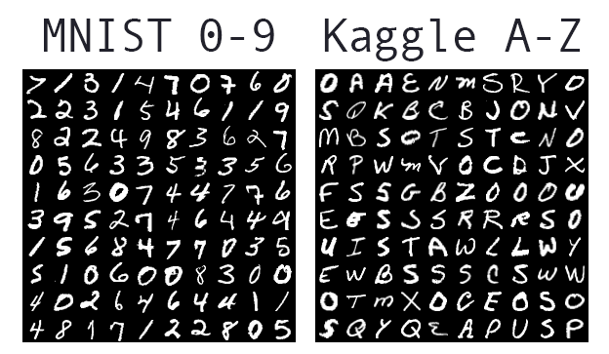
Deep learning is helping us improve our handwriting recognition accuracy by specifically for OCR algorithms
MNIST 0-9 dataset.
Kaggle A-Z dataset.
Deep neural network to recognize both digits (0-9) and alphabetic characters (A-Z).
There was a predictable and assumed space between each character.
The styles of the fonts were more conducive to OCR.

Slide 6
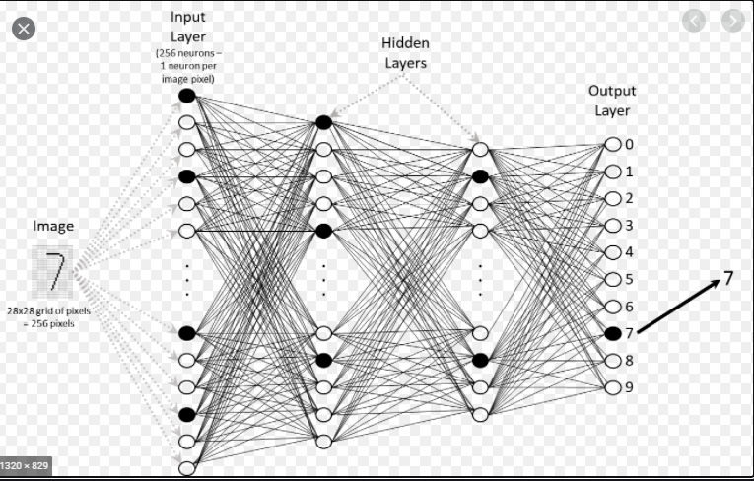

Slide 7
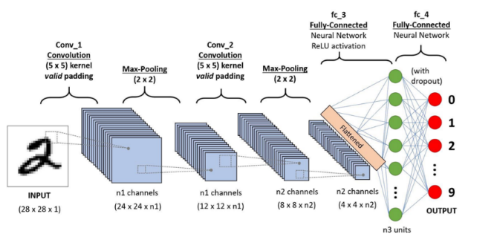
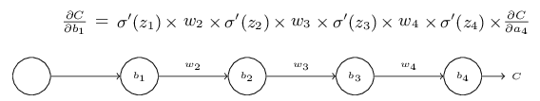

Slide 8
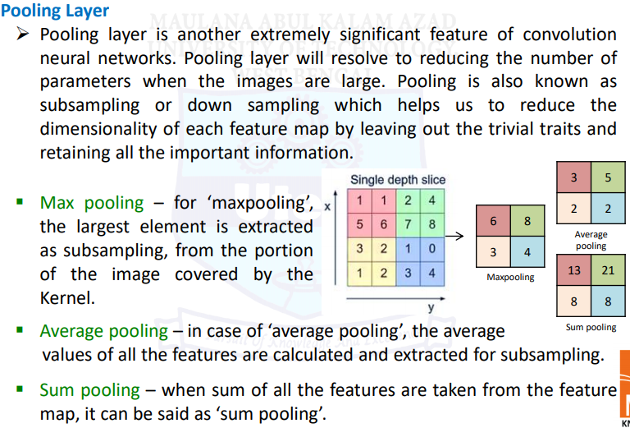

Slide 9
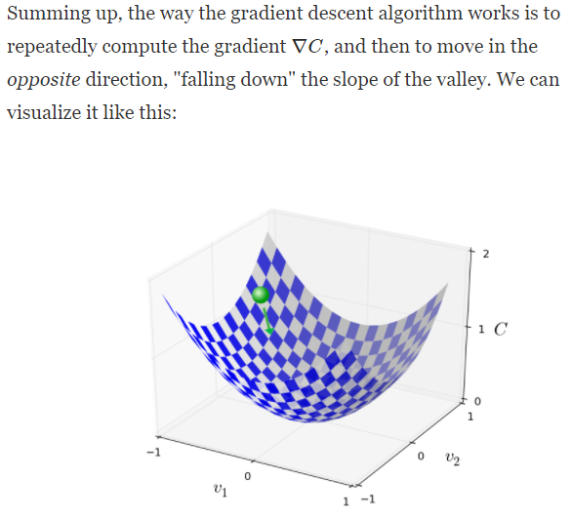
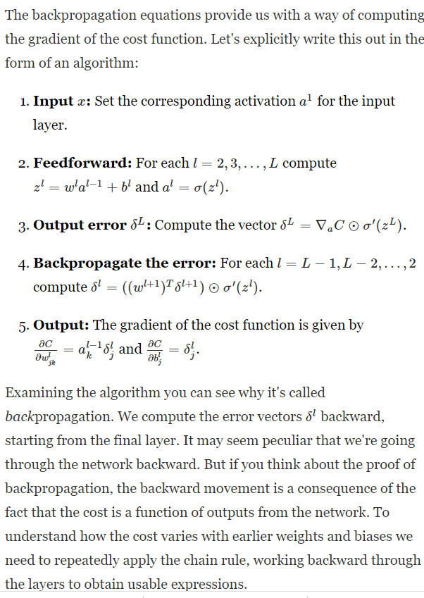
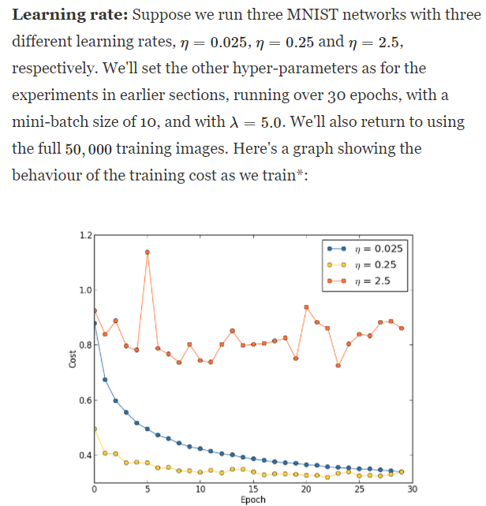

Slide 10
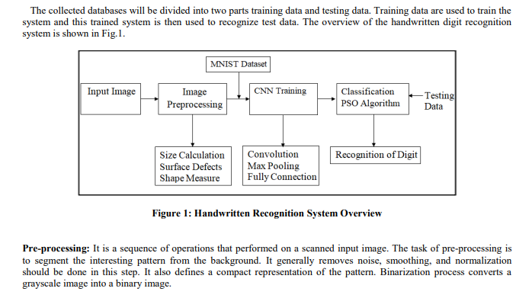

Slide 11
Deep Learning Methodology
The dense layer, there is a “Flatten” layer which transforms the data into a single dimension vector form and acts as a connection between the layers. the flatten layer is followed another dropout layer and then finally the “Dense” layer.
The “Dense” layer is a fully connected layer which is used for the output of the deep learning model. Here, every node is connected with each other and hence the major learning takes place in this layer before the output.

Slide 12
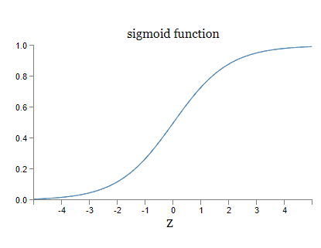
Deep Learning Methodology
There is an activation function in the dense layer called “Softmax”, which is used for getting the outputs in the form of probabilities ranging from 0 to 1. Therefore, while producing an output the algorithm tries to match the maximum probability with the input data and consequently provides the prediction.

Slide 13
Deep Learning Methodology
Then we compile the models together using the parameters “optimizer” set to “adam” as it is a very good optimizer as it combines features from both Stochastic gradient descent and RMSProp.
Loss function has been taken as “sparse_categorical_crossentropy” which is one of the widely used functions for classification problem. Metrics has been chosen as “accuracy” to check on the validation accuracy during training of the model.

Slide 14
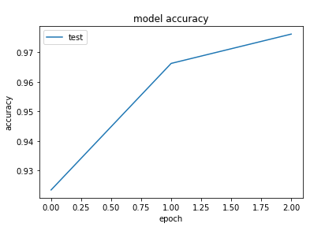
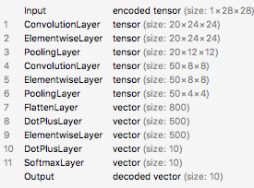
The load_model utility from Keras and TensorFlow
Makes it super simple to load our serialized handwriting recognition model.
Step 1: Tools, libraries, and packages
Step 2: Select appropriately-sized contours and extract them:
Step 3: Clean up the images using a thresholding algorithm, with a goal of having white characters on a black background:
Step 4 (continued): Now that we have list, we can finish resizing and padding:
Step 5: Detecting digits.

Slide 15
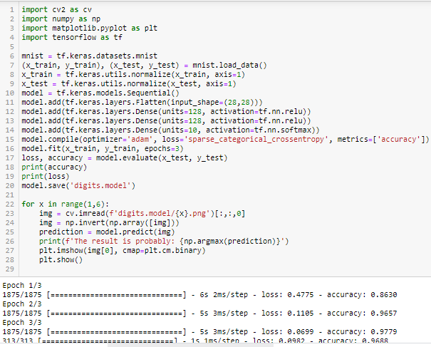

Slide 16
Results Evaluation
The final validation accuracy which we have gained is 0.9757 i.e., 97.57%. Now we will predict the images and see how well out model is performing.
We have used a combination of three outputs together. In the first case, we are printing all the probabilities which the program has calculated (“softmax” used in dense layer). We had ten different classes of letters, and the one which has the highest probability should be the correct prediction.
In the second case, the probabilities were converted again. The value of highest probability has been set as “1” while the other probabilities set to “1”. And in the third output, the corresponding image has been shown.

Slide 17
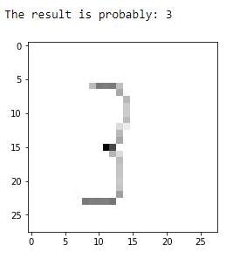
Model Results Evaluation
We take single handwritten digits to check how well our model is performing. The images were hand drawn on Microsoft Paint and saved in PNG format. The original image is intended to represent a “three”.
“Softmax” probability values of the image, where we can see corresponding probability value of “3” is the maximum.

Slide 18
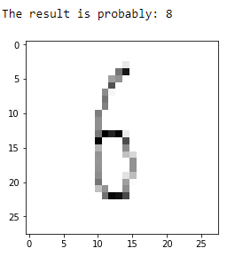
Model Results Evaluation
We take single handwritten digits to check how well our model is performing. The images were hand drawn on Microsoft Paint and saved in PNG format. The image is of a “six” number.
“Softmax” probability values of the image, where we can see corresponding probability value of “8” is the maximum.

Slide 19
Conclusion
The MNIST dataset is a widely used dataset for digital recognition in the field of data science.
The dataset consists of 70000 images, each of size 28x28 pixels. These images were then converted to grayscale images and the new dimensions were 28x28x1 which were used as sample data.
The deep learning model which has been used is Convolution Neural Networks. We have used a kernel size of 3 with MaxPooling of size 2x2 for extracting of the features. We have used “softmax” function in the dense layer of the model to get the probabilities of the predicted output.
We have used hand-written digits of two types for testing of the model. The initial examples are of digitalized hand written images prepared in Microsoft paint and then we have used real hand written image. Both the times, the results were accurate and have predicted correctly.

Slide 20
References
Lei, X., Pan, H., Huang, X., “A dilated CNN model for image classification”. July 2019 IEEE Access PP(99):1-1. DOI: 10.1109/ACCESS.2019.2927169.
Mondal, S., Dutta, A. & Chatterjee, P. (2020). Application of Deep Learning Techniques for Precise Stock Market Prediction. Proceedings of the 3rd National Conference on Machine Learning and Artificial Intelligence (NCMLAI’20), New Delhi, India, February 1, 2020. DOI: 10.13140/RG.2.2.19138.12489.
Dutta, A. and Sen, J. (2020), “Forecasting of Indian IT Sector Index using Machine Learning Techniques and LSTM”. DOI: 10.13140/RG.2.2.28357.06889/1.

